Slide 1
Project Name: IMAGE CLASSIFICATION & ANALYSIS DASHBOARD
Buildings
Forest
Glacier
Mountain
Sea
Street

Slide 2
Dataset:
Intel Image Classification Dataset 6 Classes 25,000 Images 150x150 Resolution

Slide 3
Problem Statement:
Manual identification of environmental scenes is time-consuming.
Goal:
Build a CNN model capable of automatically
classifying images into:
Buildings
Forest
Glacier
Mountain
Sea
Street

Slide 4
Architecture:
Dataset
↓
Preprocessing
↓
CNN
↓
Training
↓
Saved Model (.h5)
↓
Streamlit Dashboard

Slide 5

🤖 AI IMAGE CLASSIFIER DASHBOARD PREVIEW: BEFORE THEY CANNOT SUBMIT IMAGE FOR PERDICTION

Slide 6
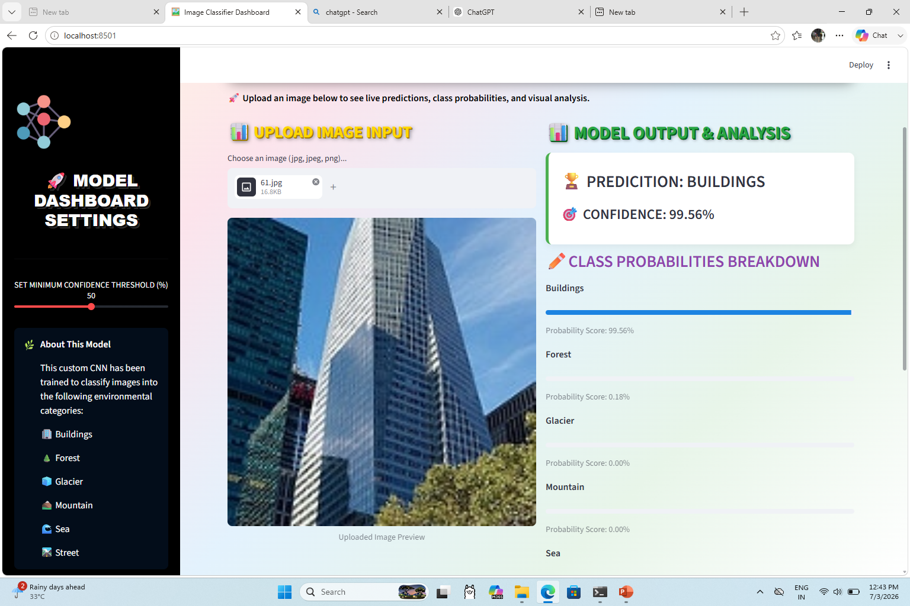
🤖 AI IMAGE CLASSIFIER DASHBOARD PREVIEW: AFTER THEY CAN SUBMIT IMAGE FOR PERDICTION

